Slide 1
CI/CD Guideline

Slide 2
Agenda
Workflow & RACI Matrix
Terminology
Details Guideline for each step
Frequently Problems
2

Slide 3
Workflow

Slide 4
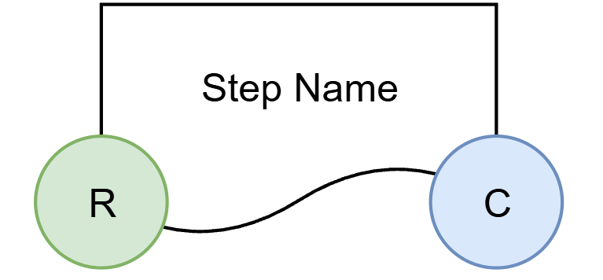
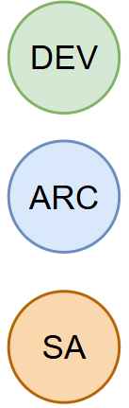
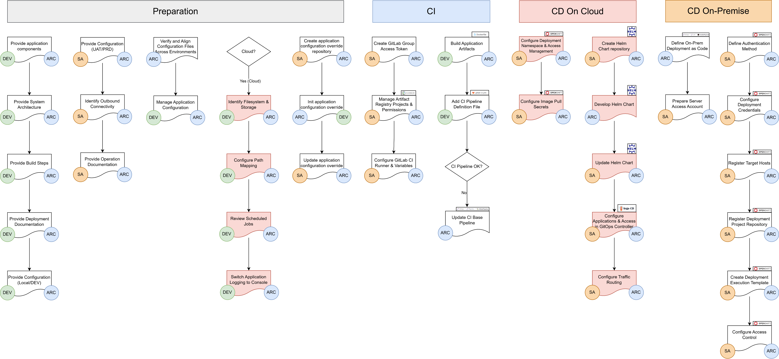
Workflow & RACI Matrix
Developer
System Architecture
Consulted
System Administrator
Responsible
4
Notes:
Vẽ được Workflow (thể hiện RACI matrix)
Thể hiện rõ vai trò của các team (Dev, SA, Architecture) trong từng công việc nếu có sự phối hợp.
Hướng dẫn quy trình cho từng loại cụ thể: API ACE, Frontend, WebApp hoặc từng framework mà nội bộ DLVN đang sử dụng (npm, maven, ....)
Identify application components and installation/operation documentation
Identify configuration files for application components
Externalize and standardize application configuration
Identify direct filesystem usage and determine the need for persistent storage mapping (PVC)
Review scheduled tasks and prefer Kubernetes CronJobs over long-running single-pod Deployments
Containerize Application (Dockerfile)
Review structure GitLab repositories
Switch Application Logging to Console Logging
Create GitOps Project with Helm Charts
Configure GitLab CI Pipeline
Update CI base pipeline
Create Harbor project and permissions
Create OpenShift namespace and RBAC
Configure image pull secrets
Prepare environment-specific configuration
Create Argo CD application and access control
Configure routing (DataPower or F5)

Slide 5
Terminology

Slide 6



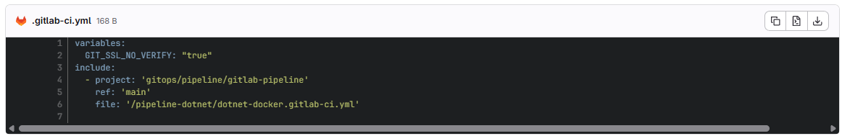
Terminology
CI/CD (Continuous Integration & Continuous Delivery/Deployment)
It’s a DevOps practice that automates building, testing, and deploying code changes, enabling faster and more reliable software releases.
GitLab CI/CD
GitLab CI/CD is a built-in feature of the GitLab version control platform, providing a complete CI/CD solution with a focus on simplicity and ease of use
CI/CD Pipeline
A CI/CD pipeline guides the process of software development through a path of building, testing, and deploying code.
YAML Ain’t Markup Language
a popular programming language
easy to read and understand
YAML file is a map or a list
Maps allow you to associate key-value pairs
GitLab CI/CD pipeline
Pipelines are configured in a .gitlab-ci.yml file by using YAML keywords.
CI Pipeline Definition File
6

Slide 7

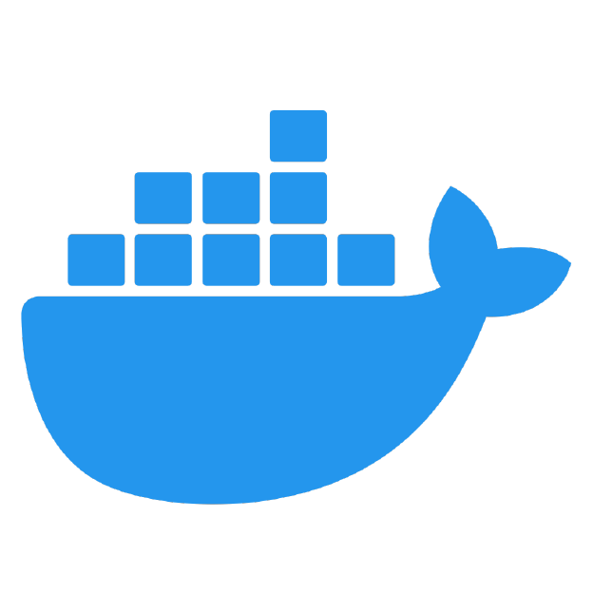

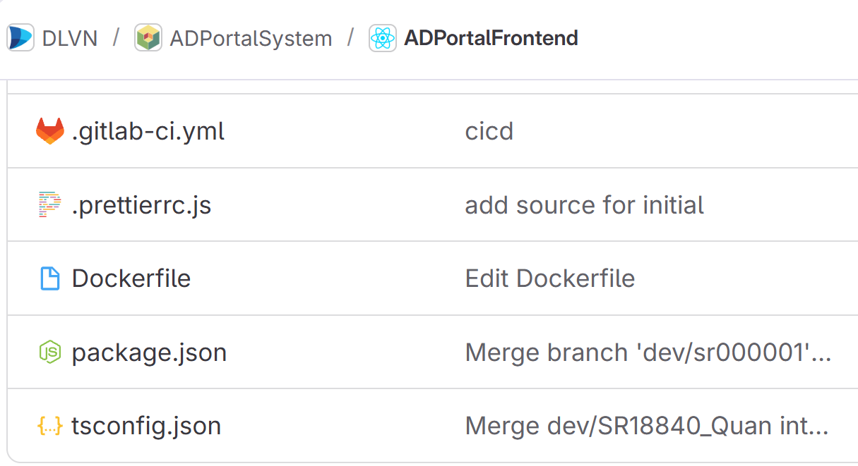

Terminology
CI/CD Jobs
CI/CD jobs are the fundamental elements of a GitLab CI/CD pipeline. Jobs are configured in the .gitlab-ci.yml file with a list of commands to execute to accomplish tasks like building, testing, or deploying code.
GitLab Runner
GitLab Runner is an application that works with GitLab CI/CD to run jobs in a pipeline.
Docker
Docker is an open source platform that enables developers to build, deploy, run, update and manage containerized applications.
A Dockerfile is a text file containing instructions for building your source code
CI Templates/ Base pipeline
A GitLab CI template is a YAML file consisting of stages, jobs (build: docker build…)
will be referenced in a different gitlab-ci.yml - to standardize, reduce implementation time
7

Slide 8


Terminology
Images
A container image is a standardized package that includes all of the files, binaries, libraries, and configurations to run a container.
Job Artifacts
Jobs can output an archive of files and directories. This output is known as a job artifact. Artifacts can include build output or report files
Artifact Registry​
An artifact registry is a centralized system for storing, tracking, and managing software artifacts, such as container images and libraries. (or build packages)
Example:
8

Slide 9
Terminology
Container
Containers are isolated processes for each of your app's components (frontend, API, database, …)
Container Orchestration
Container orchestration is the process of automating the deployment, management, scaling, and networking of containers throughout their lifecycle, making it possible to deploy software consistently across many different environments at scale.
Example: Red Hat OpenShift Container Platform
Kubernetes
Kubernetes is an open source container orchestration platform that automates many of the manual processes involved in deploying, managing, and scaling containerized applications.
Red Hat OpenShift
Red Hat® OpenShift® is an enterprise grade open source application platform
It is powered by Kubernetes as the container orchestration engine, and many more features
9

Slide 10





Terminology
Helm
Helm helps you manage Kubernetes applications
Helm Charts help you define, install, and upgrade even the most complex Kubernetes application.
Helm charts are a collection of files that describe a Kubernetes cluster’s resources and package them together as an application
GitOps
GitOps is a set of practices for managing infrastructure and application configurations to expand upon existing processes and improve the application lifecycle.
GitOps uses Git repositories as a single source of truth to deliver infrastructure as code (IaC).
GitOps Controller
Red Hat® OpenShift® is an enterprise grade open source application platform
It is powered by Kubernetes as the container orchestration engine, and many more features. Example:
10
Notes:
OpenShift resource: https://jiminbyun.medium.com/understanding-openshift-4-resource-types-25d05110526a

Slide 11




Terminology
Kubernetes cluster
A Kubernetes cluster is a set of node machines for running containerized applications. If you’re running Kubernetes, you’re running a cluster.
Kubernetes clusters are the fundamental computing unit for both Red Hat OpenShift and Kubernetes.
Each cluster has 2 parts: A control plane and worker nodes.
Control Plan
The control plane is the brains of the Kubernetes operation. It is responsible for deploying containers to worker nodes using pods, monitoring the health of nodes and pods, and addressing any failures.
Worker node
A worker node is a physical or virtual machine running either Linux or Windows. This is where your containerized software runs.
Pod
A Pod is a group of one or more application containers (such as Docker) and includes shared storage (volumes), IP address and information about how to run them.
A pod usually only holds one container (although they can hold multiple if they are tightly coupled)
11

Slide 12
Terminology
Ansible
Ansible is an open source IT automation engine that automates provisioning, configuration management, application deployment, orchestration, and many other IT processes.
12
Notes:
OpenShift resource: https://jiminbyun.medium.com/understanding-openshift-4-resource-types-25d05110526a

Slide 13
Identify application components

Slide 14
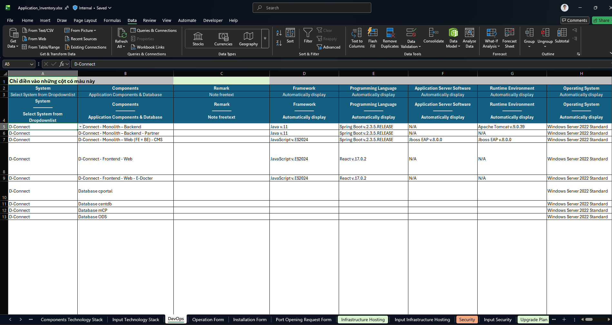
Identify application components
14

Slide 15
Provide System Architecture

Slide 16
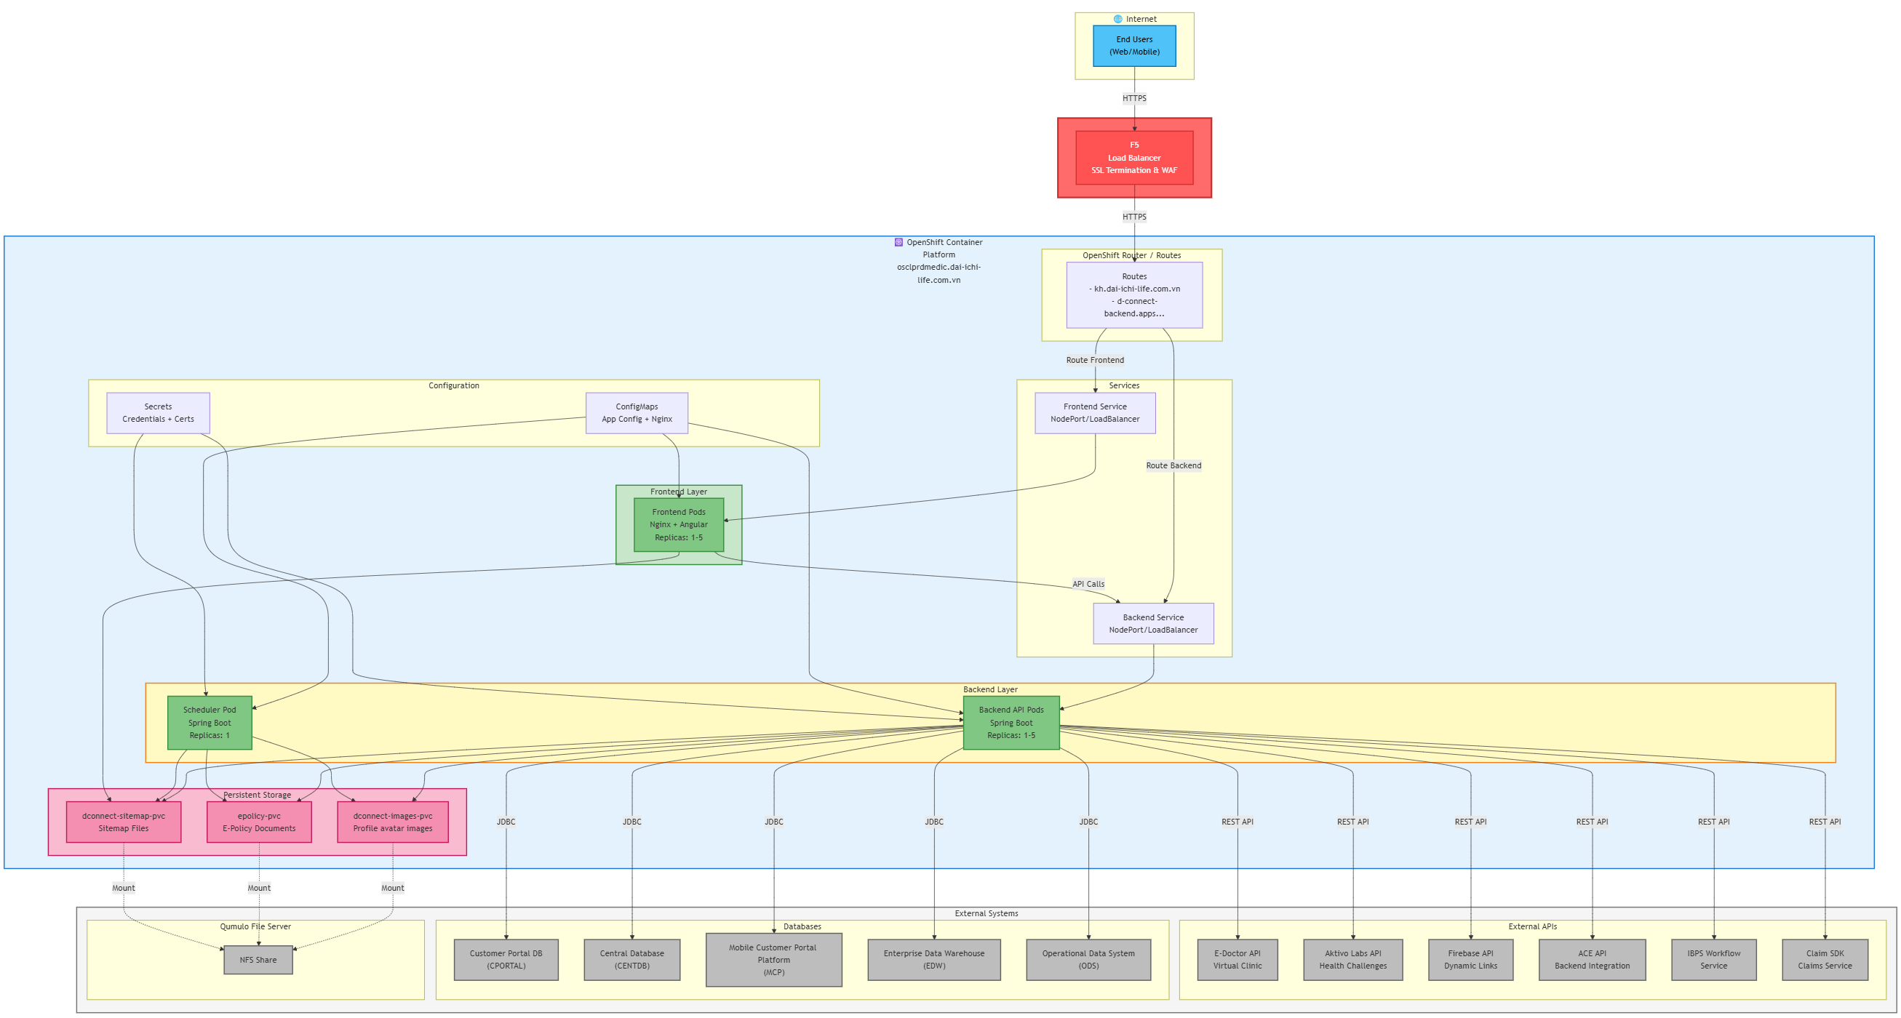
Integration Architecture Design
16

Slide 17
Provide Build Steps

Slide 18
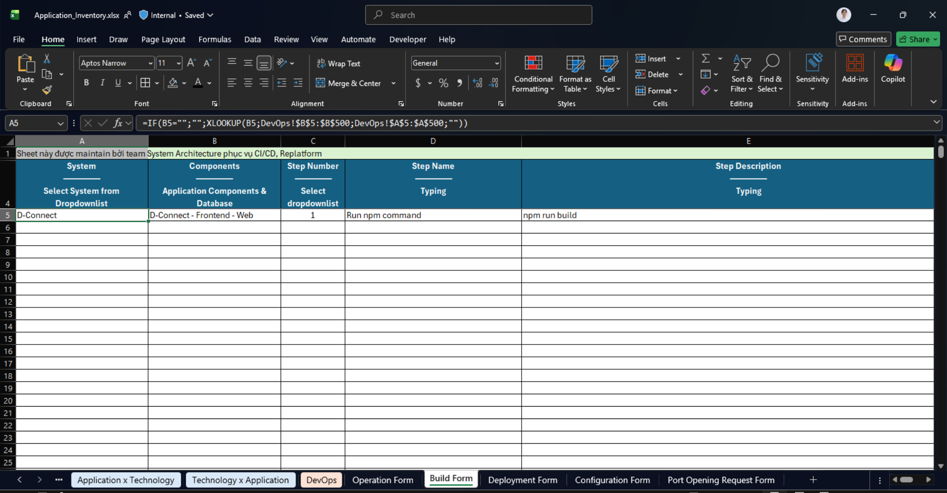
Provide Build Steps
What
Identify and provide the build steps and commands to compile and package the source code into deployable artifacts (files, Docker images…) when the build is executed.
Why
Ensure the CI/CD pipeline accurately replicates the real environment, reducing deployment errors and supporting reliable automated deployments.
18

Slide 19
Provide Deployment Documentation

Slide 20
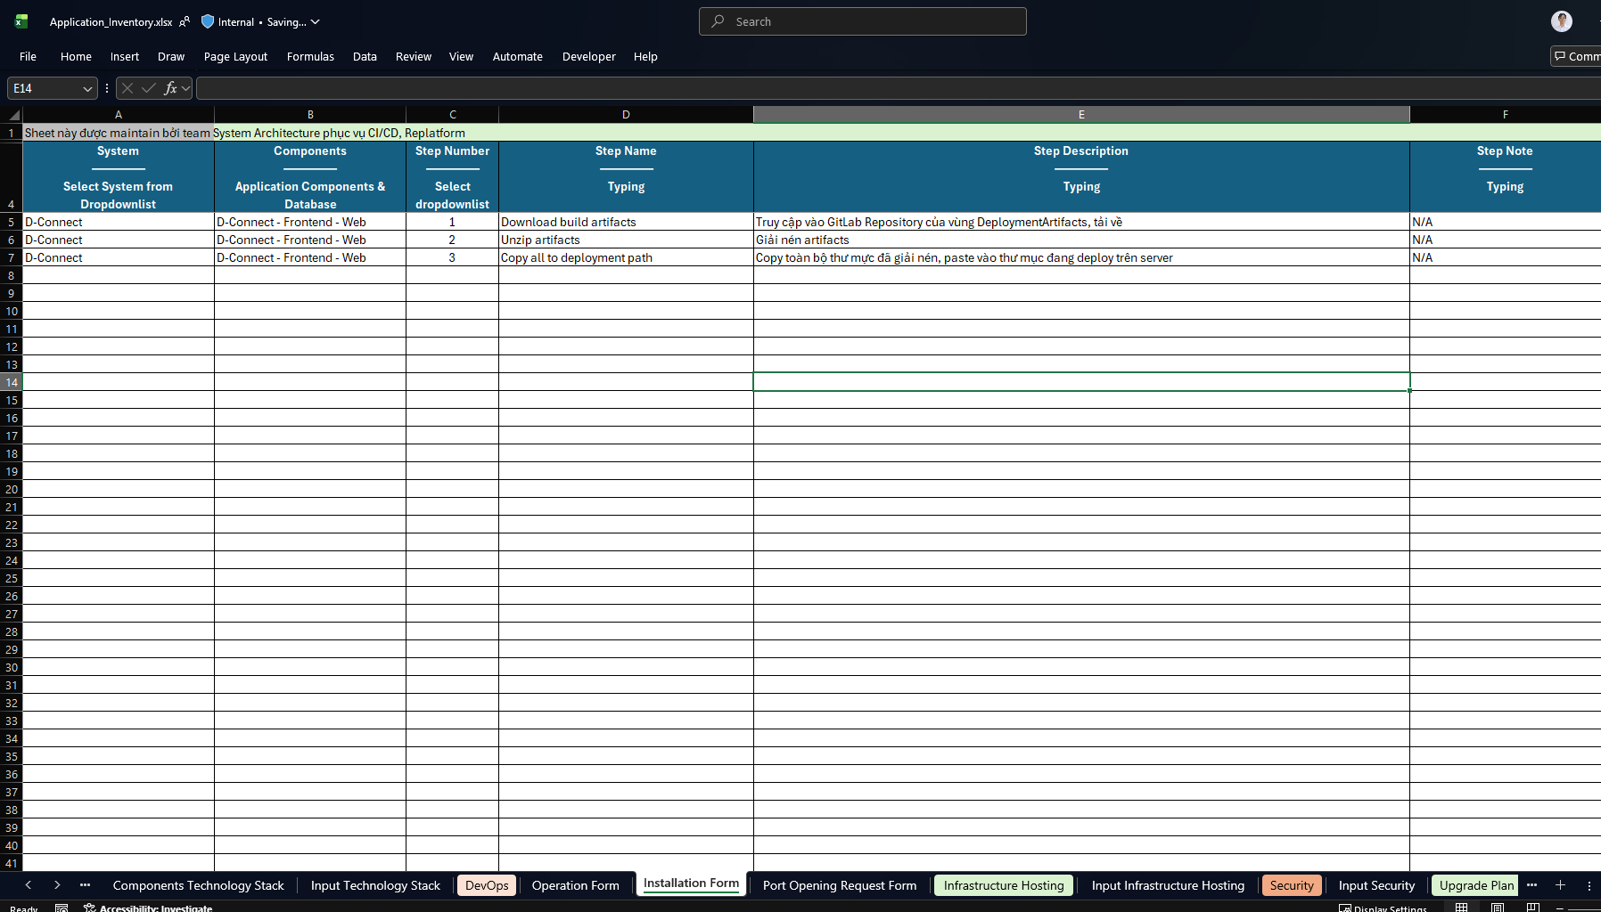
Provide Deployment Documentation
What
Provide installation/promote documentation for application components
Why
Ensure the CI/CD pipeline accurately replicates the real environment, reducing deployment errors and supporting reliable automated deployments.
20

Slide 21
Provide Configuration
(Local, DEV)

Slide 22
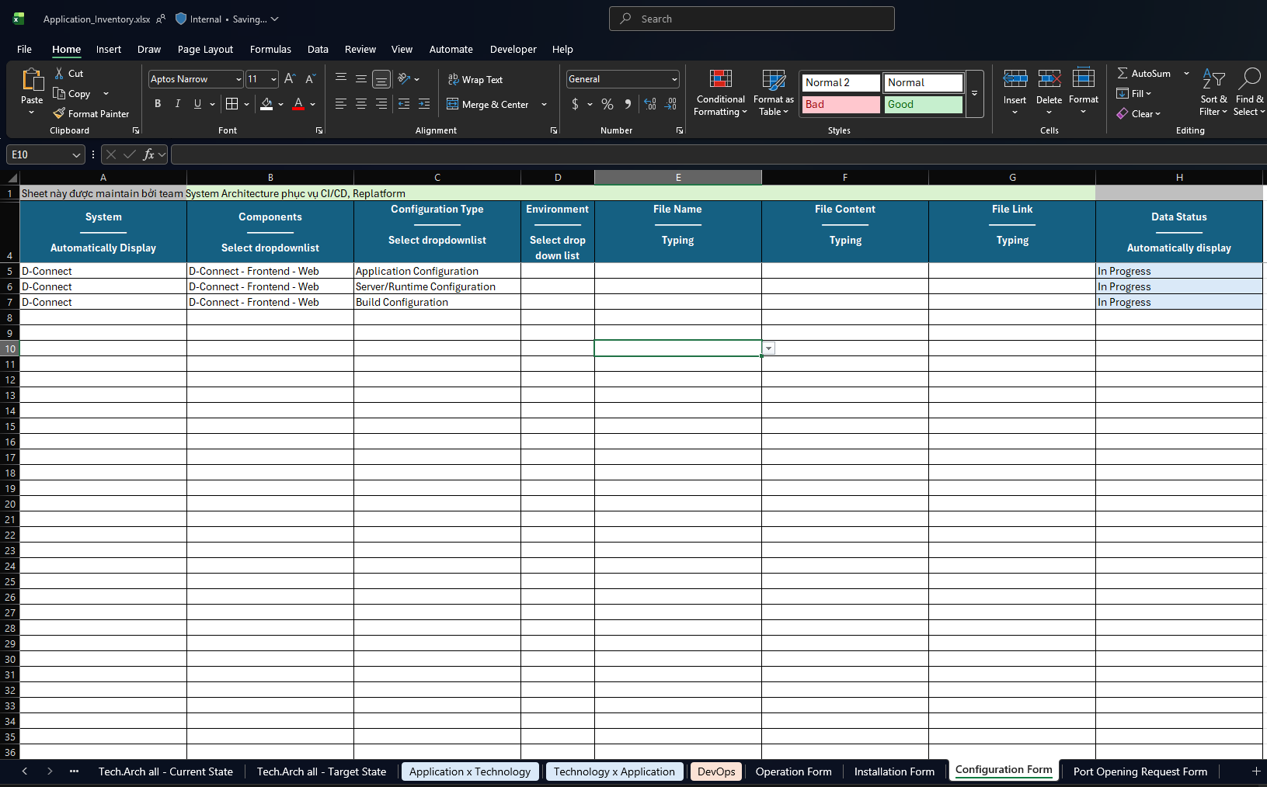
Provide Configuration (Local, DEV)
What
Identify configuration files for application components in the local or development environment.
Why
Ensure no config files are missing, prevent runtime errors, and maintain consistent file management across environments.
22

Slide 23
Provide Configuration
(UAT, PRD)

Slide 24
Provide Configuration (UAT, PRD)
What
Identify configuration files for application components in the UAT or production environment.
Why
Ensure no config files are missing, prevent runtime errors, and maintain consistent file management across environments.
24

Slide 25
Identify Outbound Connectivity

Slide 26
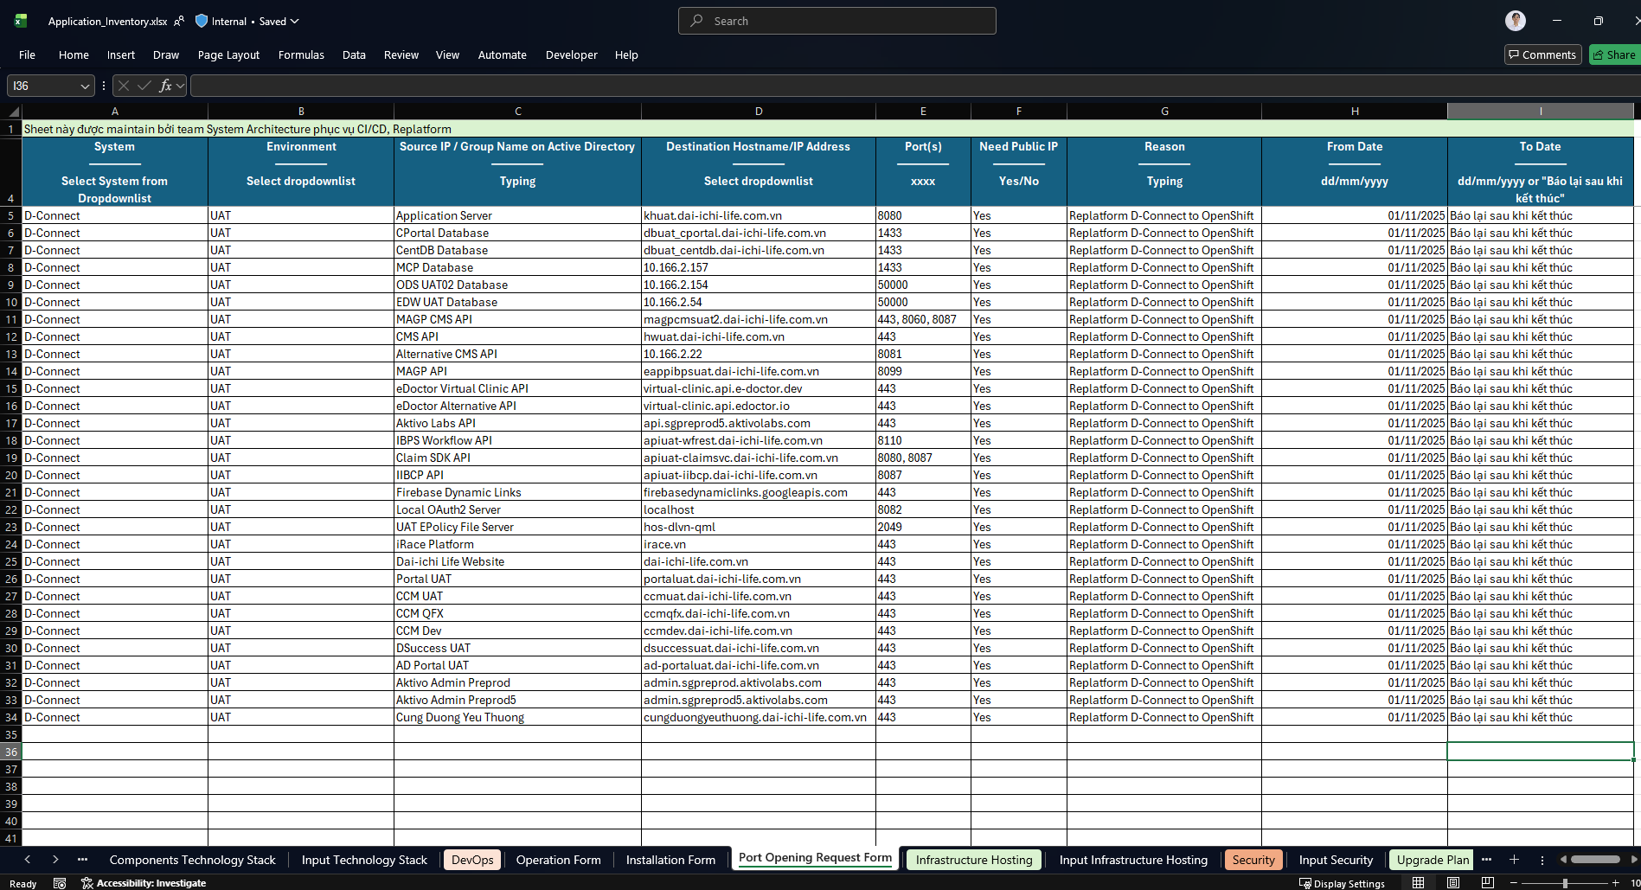
Identify Outbound Connectivity
What
Identify required outbound connections (ports, protocols, destinations) to support egress/ingress and network policies.
Why
This step ensures the application’s network requirements are understood, enabling accurate network policy configuration, enhanced security, and reliable operation
26

Slide 27
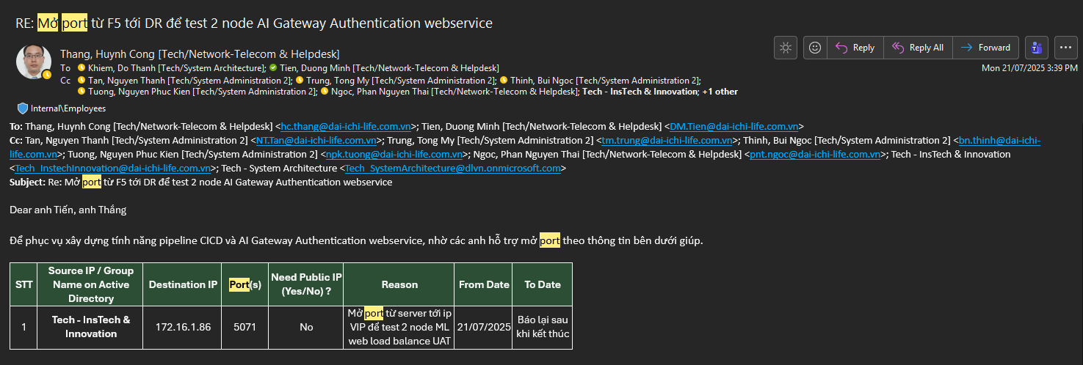
Identify Outbound Connectivity
27

Slide 28
Provide Operation Documentation

Slide 29
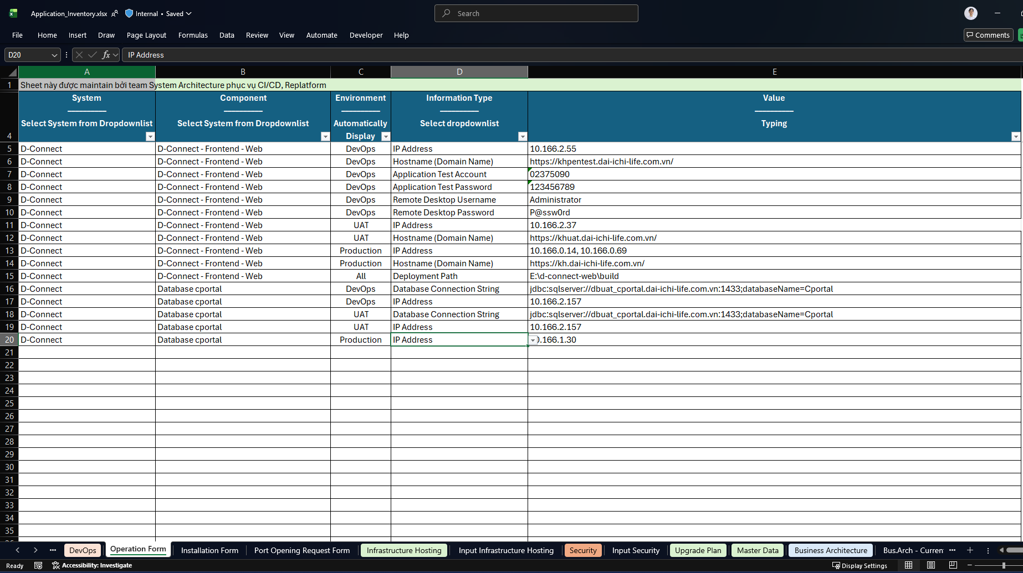
Provide Operation Documentation
29

Slide 30
Verify and Align Configuration Files Across Environments

Slide 31
Verify and Align Configuration Files Across Environments
HÌNH MINH HỌA
What
Confirm with both the local DEV and UAT SA to ensure the file locations are consistent, as files may be stored differently between local and UAT environments.
Why
Ensure the CI/CD pipeline accurately replicates the real environment, reducing deployment errors and supporting reliable automated deployments.
31

Slide 32
Manage Application Configuration

Slide 33
Manage Application Configuration
HÌNH MINH HỌA
What
Move configuration files out of the packaged application (WAR/JAR) so that the application reads them from an external source—either an external path via environment variables defined in the Helm Chart or from a dedicated Application Configuration repository on GitLab storing the variables (for Ansible Playbook use cases).
Why
Allows flexible config management across environments without rebuilding the app and ensures correct mounting in CI/CD deployments.
33

Slide 34
Identify
Filesystem & Storage

Slide 35
Identify Filesystem & Storage
MINH HỌA HƯỚNG DẪN
What
Identify direct filesystem usage (Qumulo) and determine the need for persistent storage mapping (PVC)
Why
Ensure correct access and permissions for shared storage, replicate filesystem behavior in OpenShift, and prevent runtime errors due to missing or inaccessible folders.
35

Slide 36
Configure Path Mapping

Slide 37
Configure Path Mapping
MINH HỌA HƯỚNG DẪN
What
Implement path conversion using FileServerUtil with feature flags (pathInDatabaseMode) to map shared folder paths from network drives to container mount paths at runtime.
Why
Ensures the app reads/writes files correctly in production containers, handling dev vs. converted vs. relative paths consistently.
37

Slide 38
Review Scheduled Jobs

Slide 39
Review Scheduled Jobs
MINH HỌA HƯỚNG DẪN
What
Review scheduled tasks and modify the app to add a config flag (in .config file or environment variable) to enable/disable scheduled jobs, allowing separate deployments for the app and for jobs via Helm Chart.
Why
Ensures scheduled jobs run independently from the main application, enabling flexible deployment and easier management on OpenShift.
39

Slide 40
Switch Application Logging to Console Logging

Slide 41
Switch Application Logging to Console Logging
MINH HỌA HƯỚNG DẪN
What
Configure the app to log to console instead of files so a logging agent can collect logs from pods and send them to a centralized logging system.
Why
Allows a logging agent (OpenShift) to collect pod logs automatically and forward them to centralized logging system (ELK), ensuring centralized log management for CI/CD environments.
41

Slide 42
Prepare application configuration override repository

Slide 43
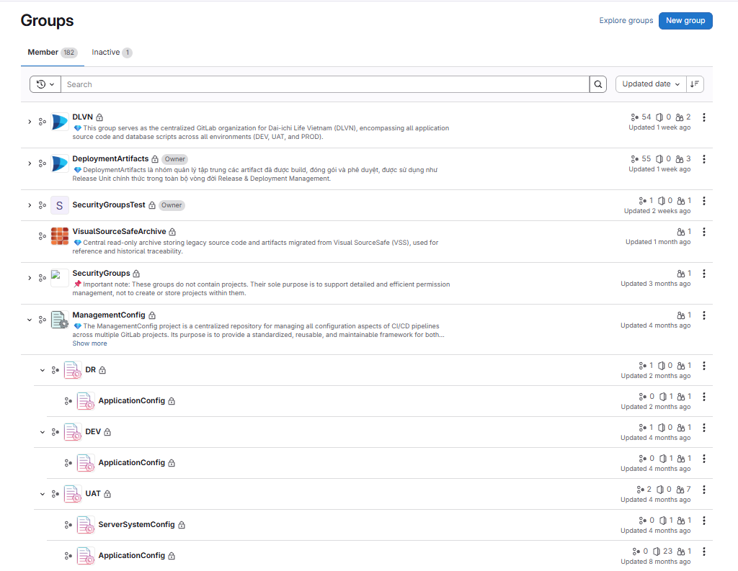
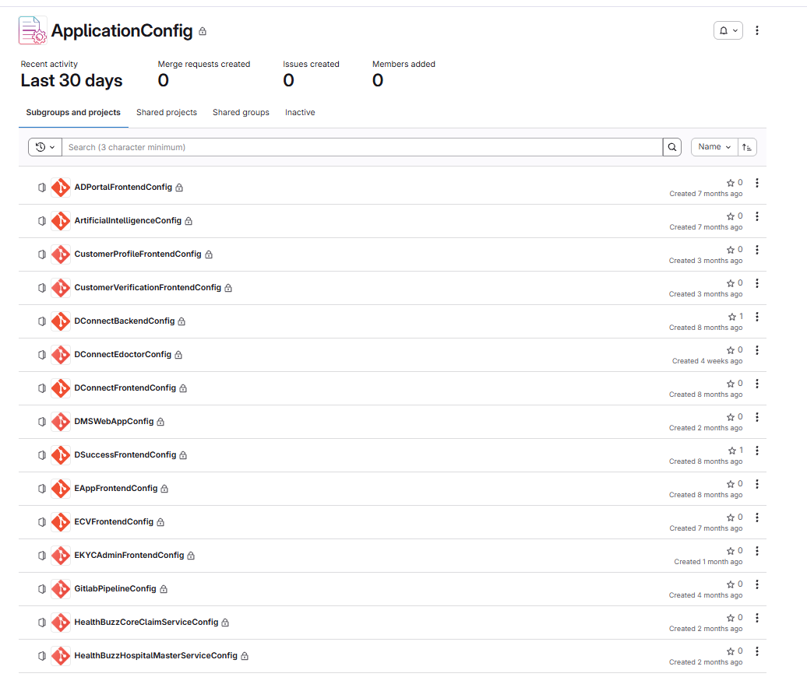
Create application configuration repository
43

Slide 44
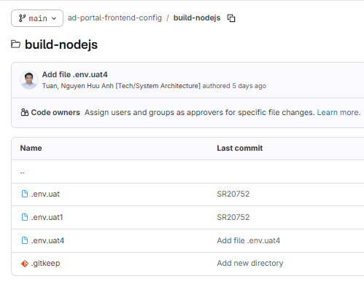
Init application configuration repository
44

Slide 45
Update application configuration repository
45

Slide 46
Create GitLab Group Access Token

Slide 47

Create GitLab Group Access Token
Guideline_Create_GitLab_Group_Access_Token.pdf
Chưa tồn tại, cần develop
47

Slide 48
Manage Artifact Registry Projects & Permissions

Slide 49
Manage Artifact Registry Projects & Permissions
Guideline_Create_Harbor_Project_Permissions.pdf
Chưa tồn tại, cần develop
49

Slide 50
Configure GitLab CI Runner & Variables

Slide 51
Configure GitLab CI Runner & Variables
[Guideline]_Implementation_Gitlab_Security_Quality_Review.pdf
Section: Install and register GitLab Runner for each project
51

Slide 52
Build Application Artifacts

Slide 53
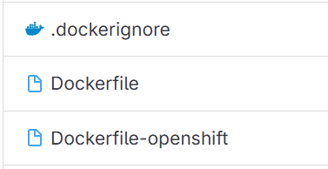
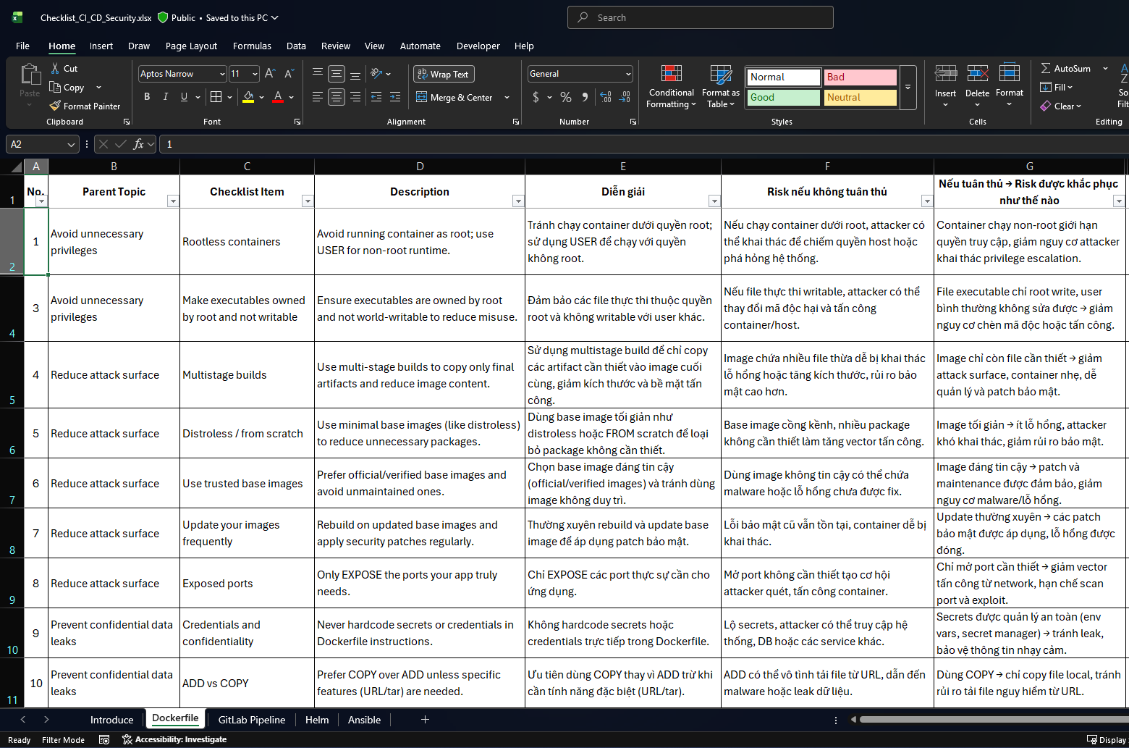
Build Application Container
# -------------------
# 1. Build stage
# -------------------
FROM <build-base-image> AS build
# Set working directory
WORKDIR <build-dir>
# Copy project files
COPY <project-config-files> .
COPY <source-code-dir> <target-dir-in-container>
# Optional: copy build settings (maven/gradle/npm)
COPY <build-settings-file> <container-settings-path>
# Build project (compile/package)
RUN <build-command> --options <skip-tests-or-docs> --cache <optional-cache-dir>
# -------------------
# 2. Runtime stage
# -------------------
FROM <runtime-base-image>
# Set working directory
WORKDIR <runtime-dir>
# Set environment variables
ENV <APP_ENV_VAR_1>=<value>
ENV <APP_ENV_VAR_2>=<value>
ENV <APP_JAR_OR_BINARY>=<artifact-name>
ENV <APP_OPTS>=<runtime-options>
# Copy artifact from build stage
COPY --from=build <build-artifact-path> <runtime-artifact-path>
# Optional: expose port if network service
EXPOSE <port>
# Set entrypoint / command to run the app
ENTRYPOINT ["<runtime-command>", "<artifact-or-binary>", "<runtime-options>"]
.dockerignore: prevents unnecessary or sensitive files from being included, reducing image size, speeding up builds, and improving security.
Dockerfile: builds artifacts to run on-premises.
Dockerfile-openshift: includes the build steps from the Dockerfile and adds runtime configuration for OpenShift.
Comply with the Dockerfile best practices checklist for quality and security as issued in the document below.
Use the Dockerfile template
53
Notes:
Cách làm này là cần thiết vì một số dự án (ví dụ: Replatform) cần chạy cùng lúc trên on-premises và cloud. Load balancing qua F5 đảm bảo rằng nếu môi trường cloud gặp sự cố, lưu lượng sẽ được chuyển về on-premises, giữ tính sẵn sàng cao và ổn định.

Slide 54
Add CI Pipeline Definition File

Slide 55
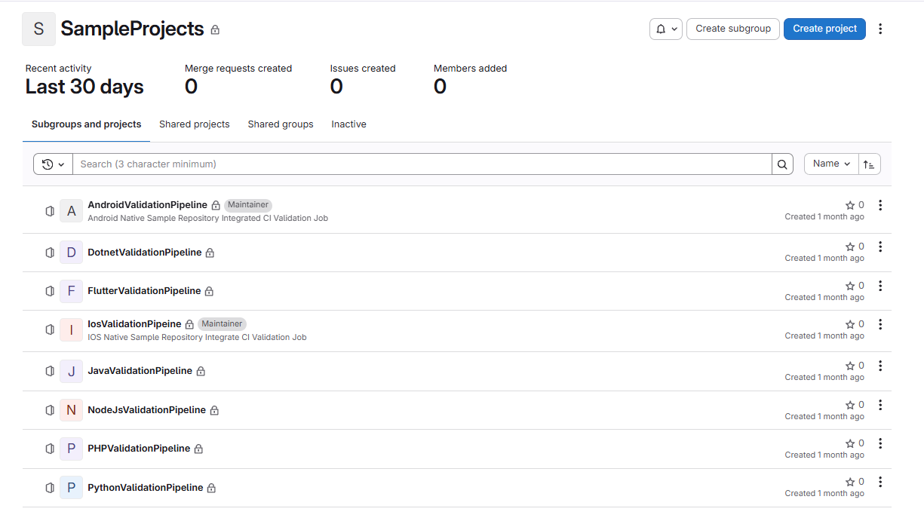
Add CI Pipeline Definition File
Write a .gitlab-ci.yml file in each project that requires CI (copy the template file from sample project).
If there is no existing template, the System Architecture team must create a new base pipeline in the base pipeline step below and then create a sample project containing a .gitlab-ci.yml file to serve as a reference template.
55

Slide 56
Update CI Base Pipeline

Slide 57
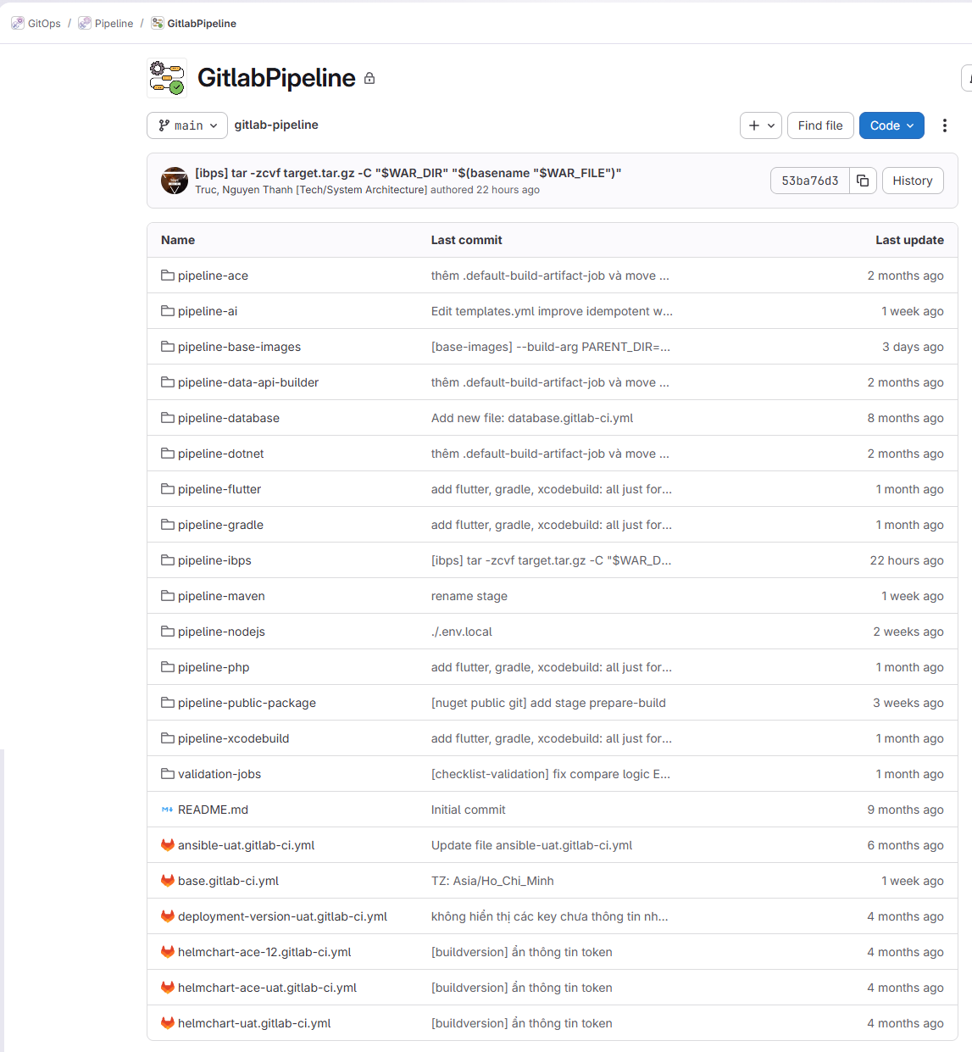
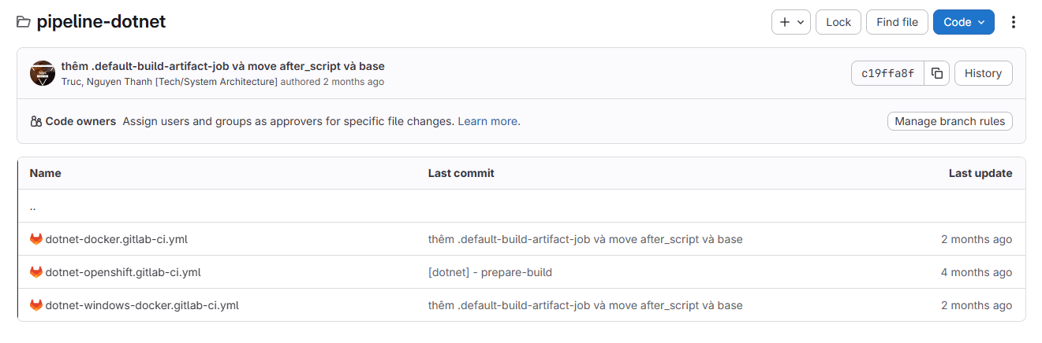
Update CI Base Pipeline
2 types of base pipelines:
Framework-specific bases
Common base shared across all frameworks.
Example:
- pipeline-dotnet/dotnet-openshift.gitlab-ci.yml
- base.gitlab-ci.yml
57

Slide 58
Update CI Base Pipeline
2 types of base pipelines:
Framework-specific bases
Common base shared across all frameworks.
Example:
- pipeline-dotnet/dotnet-openshift.gitlab-ci.yml
- base.gitlab-ci.yml
58

Slide 59
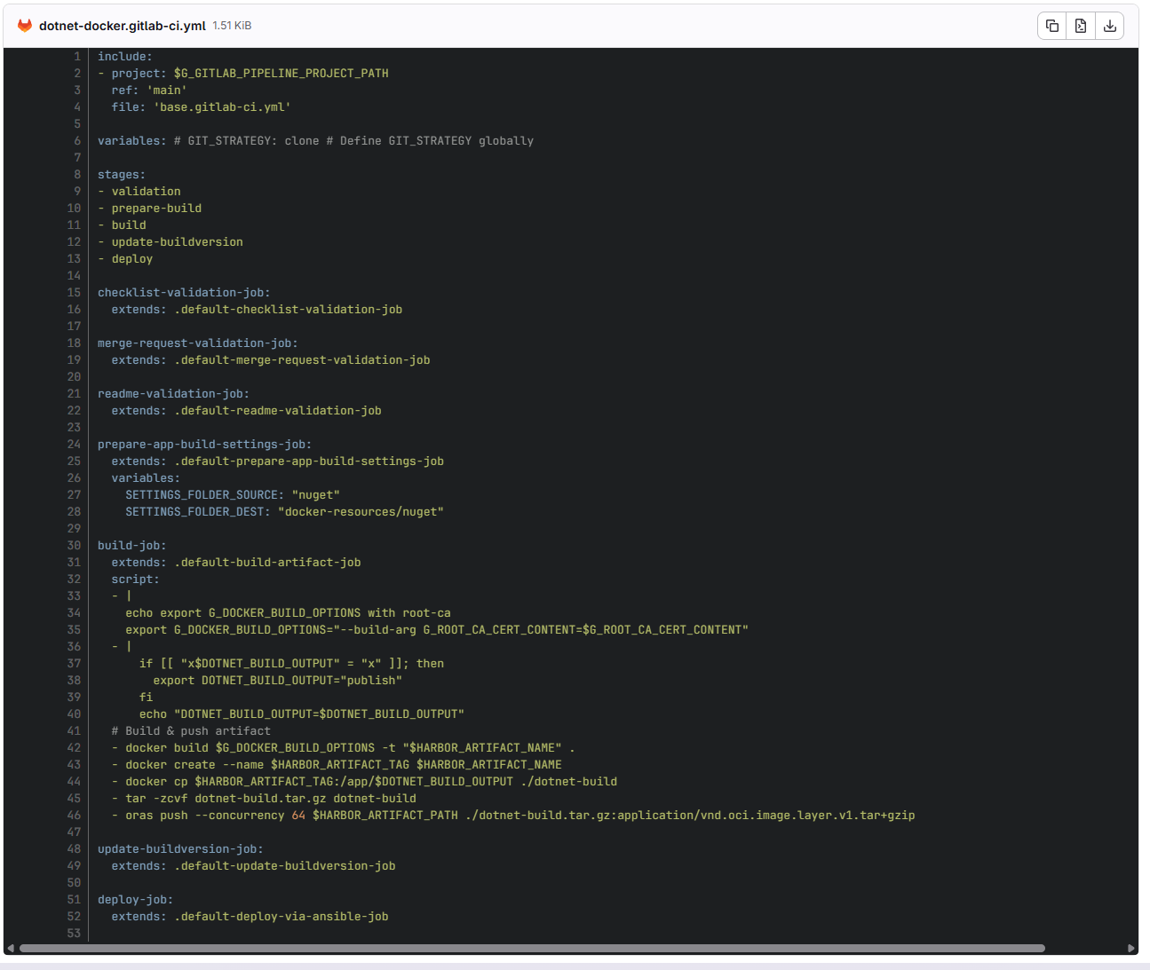
Framework-Specific Base Development Guidelines
Keep, do not change
Copy from an existing base pipeline and keep the original structure:
includes, stages
checklist-validation-job, merge-request-validation-job, readme-validation-job
prepare-app-build-settings-job
build-job
update-buildversion-job
deploy-job.
Only modify the following stages:
prepare-app-build-settings-job
build-job
Modify if needed
Keep, do not change
59

Slide 60
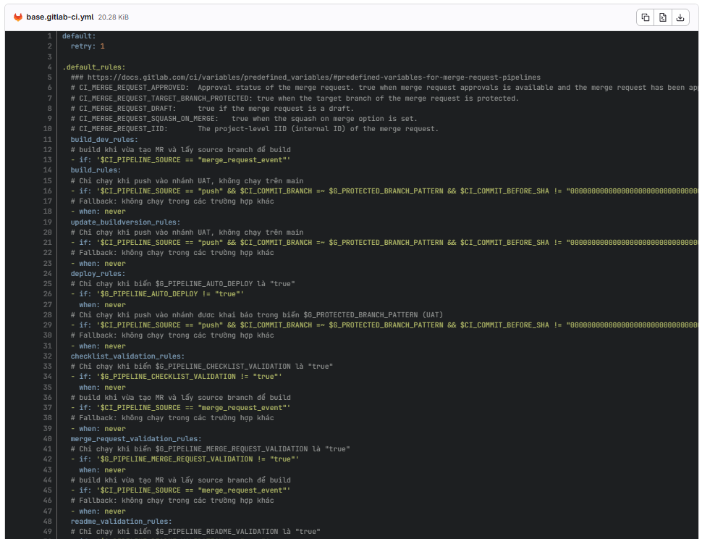
Common Base Development Guideline
Common Base is the base.gitlab-ci.yml file that provides shared functions used across multiple framework-specific base pipelines. Any modifications to this file must be reviewed and approved by the System Architecture team.
60

Slide 61
Configure Deployment Namespace & Access Management

Slide 62
Configure Cloud Namespace & Access Management
MINH HỌA HƯỚNG DẪN
What
Create OpenShift namespace and RBAC following DevOps Operation Standards document
Why
Ensure traceability, and secure deployment management.
62

Slide 63
Configure Image Pull Secrets

Slide 64
Configure Image Pull Secrets
MINH HỌA HƯỚNG DẪN
What
Annual
Configure image pull secrets on OpenShift, GitLab Variables (Global Admin Area) following DevOps Operation Standards document
Why
Enable secure image pulls from the private registry.
64

Slide 65
Helm Charts

Slide 66
Create Helm Charts repositories
MINH HỌA HƯỚNG DẪN
What
Follow pattern name HelmChart<GitLabSystemGroupName><Environment> following DevOps Operation Standards document
Why
Ensure version-controlled Helm charts for automated OpenShift deployments with correct configuration and persistent data.
66

Slide 67
Develop Helm Charts
MINH HỌA HƯỚNG DẪN
What
Develop Helm charts following the DevOps Engineering Standards document
Why
Enable standardized and automated deployments.
67

Slide 68
Update Helm Charts
MINH HỌA HƯỚNG DẪN
What
Update Helm Charts
Why
Keep deployments accurate and up to date.
68

Slide 69
Configure Applications & Access in GitOps Controller

Slide 70
Configure Argo CD Applications & Access
MINH HỌA HƯỚNG DẪN
What
Create the Argo CD project and application, configure the Helm chart and environment-specific values, and assign access permissions following the DevOps Operation Standards document
Why
To enable controlled and automated deployments to OpenShift while allowing the team to monitor and manage releases securely.
70

Slide 71
Configure Traffic Routing

Slide 72
Configure Traffic Routing
MINH HỌA HƯỚNG DẪN
What
Configure traffic routing using DataPower or F5 to map domains, IPs, and ports to OpenShift services and enable load balancing following the DevOps Operation Standards document
Why
To ensure stable and seamless access to applications, and support failover or parallel routing between on-prem and OpenShift environments.
72

Slide 73
Define On-Prem Deployment as Code

Slide 74
Define On-Prem Deployment as Code
What
MINH HỌA HƯỚNG DẪN
Define deployment automation for On-Prem environments by creating deployment manifests and scripts (currently implemented using Ansible playbooks) to standardize application rollout across servers.
Following DevOps Engineering Standards document
Why
To codify the deployment process as automation so releases can be executed consistently and safely across environments, minimizing manual steps and enabling reliable Continuous Deployment.
74

Slide 75
Prepare Server Access Account

Slide 76
Prepare Server Access Account
MINH HỌA HƯỚNG DẪN
What
Create a dedicated remote user account on target servers for deployment automation and grant required permissions for application deployment tasks.
Following DevOps Operation Standards document
Why
Allow Ansible to securely connect and execute deployment operations without using personal or root accounts.
76

Slide 77
Define Authentication Method

Slide 78
Define Authentication Method
MINH HỌA HƯỚNG DẪN
What
Define or select the appropriate credential type in Ansible (e.g., Machine/SSH, Source Control, or custom type) to specify the authentication schema required for remote connections.
Following DevOps Operation Standards document
Why
Standardize how authentication information is structured and securely managed, enabling reusable and consistent credential configuration across projects.
78

Slide 79
Configure Deployment Credentials

Slide 80
Configure Deployment Credentials
MINH HỌA HƯỚNG DẪN
What
Register the server access credentials (username/password or SSH key) in Ansible to authenticate remote connections.
Following DevOps Operation Standards document
Why
Enable secure and centralized credential management for automated deployments.
80

Slide 81
Register Target Hosts

Slide 82
Register Target Hosts
MINH HỌA HƯỚNG DẪN
What
Add target servers (hostname/IP/port/credential) into Ansible inventory for deployment targeting.
Following DevOps Operation Standards document
Why
Allow Ansible to know where deployments should be executed.
82

Slide 83
Register Deployment Project Repository

Slide 84
Register Deployment Project Repository
MINH HỌA HƯỚNG DẪN
What
Create an Ansible Project linked to the Git repository containing deployment playbooks.
Following DevOps Operation Standards document
Why
Allow Ansible to fetch and version-control deployment automation scripts.
84

Slide 85
Create Deployment Execution Template

Slide 86
Create Deployment Execution Template
MINH HỌA HƯỚNG DẪN
What
Create a Job Template that defines inventory, project, playbook, credentials, and runtime variables for executing deployments.
Following DevOps Operation Standards document
Why
Provide a standardized and repeatable way to trigger deployments.
86

Slide 87
Configure Access Control

Slide 88
Configure Access Control
MINH HỌA HƯỚNG DẪN
What
Create teams, enable LDAP login, assign users, and grant appropriate roles to access deployment resources
Following DevOps Operation Standards document
Why
Ensure only authorized users can trigger or manage deployments while maintaining auditability.
88

Slide 89
Frequently Problems

Slide 90
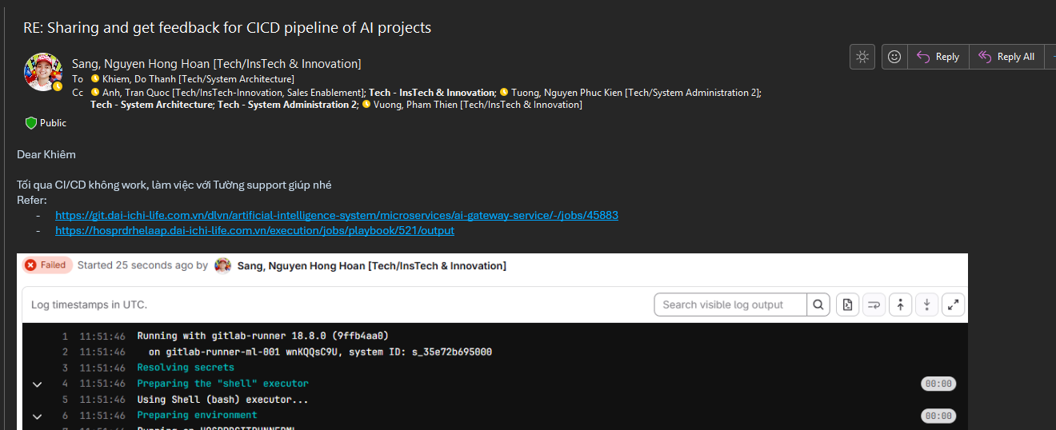
Frequently Problems
Thể hiện những vấn đề thường gặp (collect từ kinh nghiệm của anh Trực, anh Tuấn, anh Khiêm)
Chuẩn hoá cấu hình Git safe.directory trong CI/CD pipeline nhằm ngăn lỗi “dubious ownership” khi working directory của repository được tạo hoặc mount với ownership khác nhau. Việc này giúp đảm bảo các thao tác Git chạy ổn định, nhất quán trên các môi trường automation, đồng thời vẫn duy trì cơ chế bảo vệ an ninh của Git.
Tạo nhánh không đúng quy tắc → CI/CD không chạy (VD: trường hợp anh Tình EKYCAdminFrontend)
90

Slide 91
Demonstration Images

Slide 92
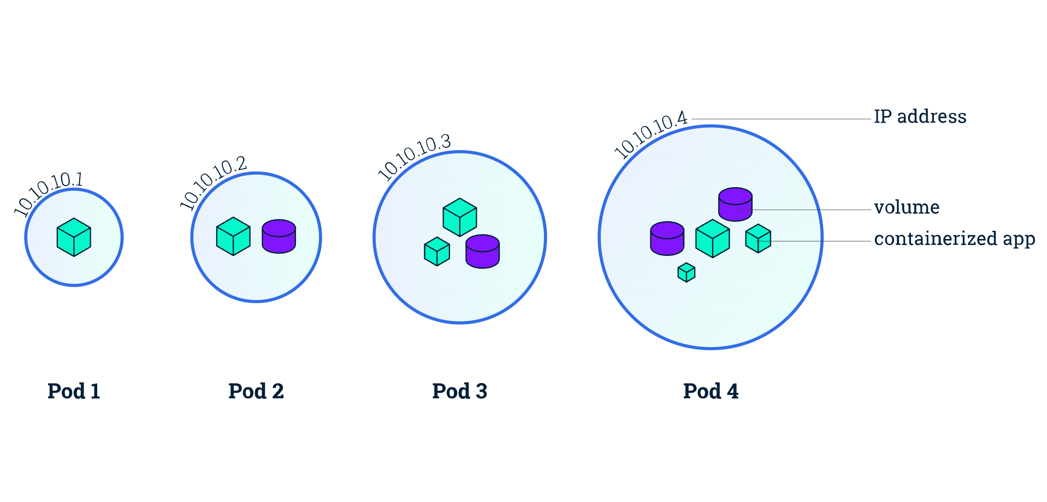
Pods
Viewing Pods and Nodes
92

Slide 93
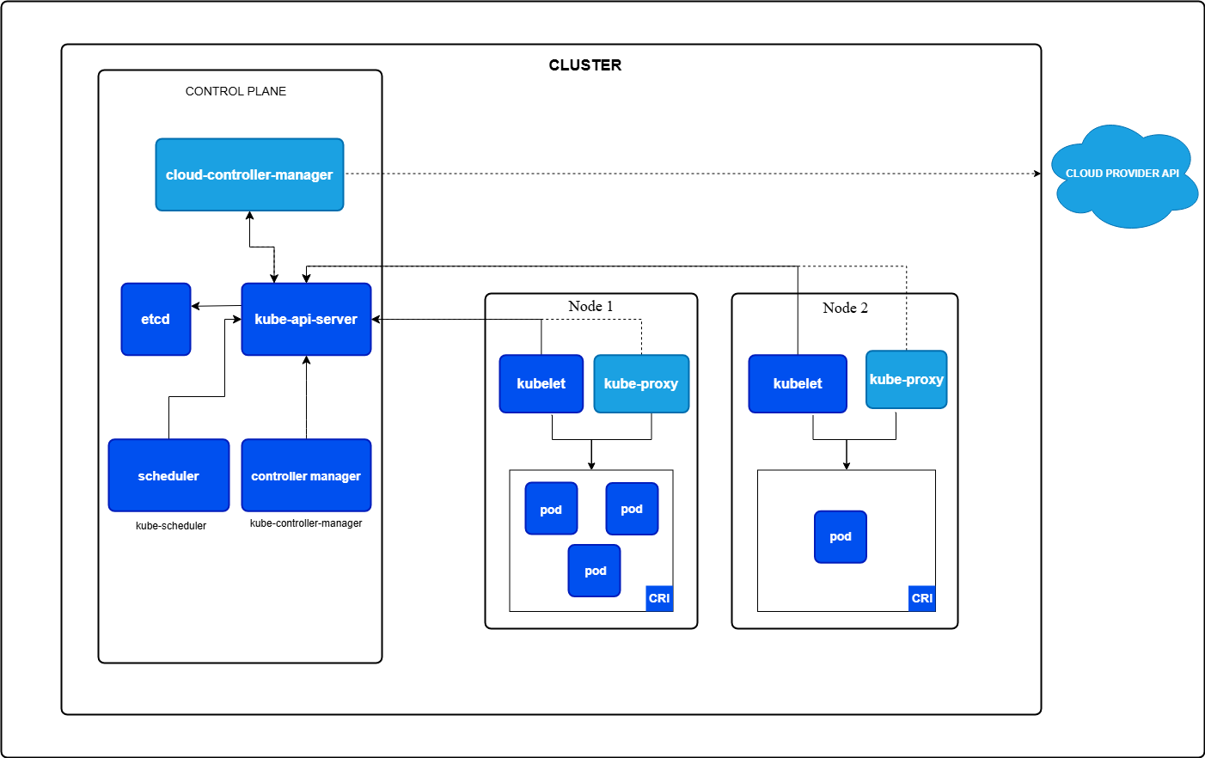
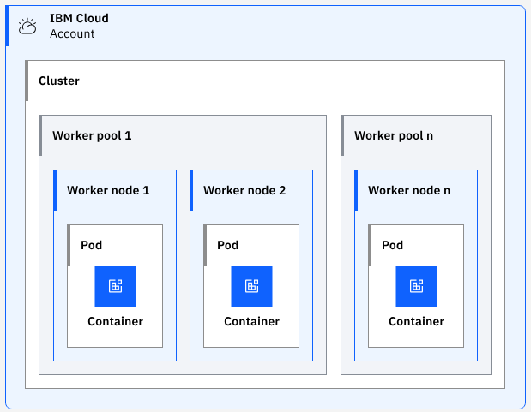
Cluster Architecture
The control plane It is responsible for deploying containers to worker nodes
The worker node(s) host the Pods that are the components of the application workload.
cloud-controller-manager runs controllers specific to the cloud environment in which your cluster is hosted. This allows you to link your cluster into your cloud providers API (Load Balancer, Storage)
kubelet This is the agent that communicates with the control plane.
kube-proxy This is the network proxy that forwards requests to a particular service on a specific pod (which provides an instance of that service).
kube-apiserver The Kubernetes API is central to the control plane and allows cluster components and end-users to communicate
etcd The key-value store that holds all configuration data relating to the cluster and acts as the single source of truth. (/etc daemon)
A pod usually only holds one container
Container runtime This is the software that runs the containers
kube-controller-manager The controller manager runs the various controller processes (noticing and responding when nodes go down, …)
CRI - Container Runtime Interface - enables the kubelet to use a wide variety of container runtimes, without having a need to recompile the cluster components.
kube-scheduler The scheduler is responsible for assigning pods to nodes. New pods are assigned to nodes based on a number of factors, including resource requirements and other constraints that may have been applied.
Cluster Architecture
93
Notes:
https://kubernetes.io/docs/concepts/architecture/
https://konghq.com/blog/learning-center/kubernetes-architecture

Slide 94
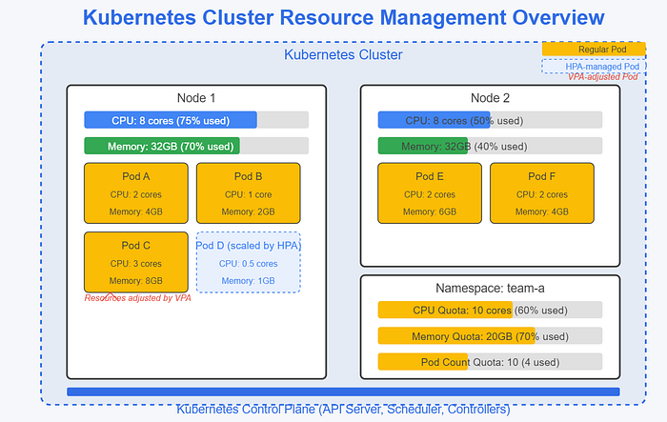
Cluster’s Resources
Cluster’s resources
94
Notes:
https://kubernetes.io/docs/concepts/architecture/
https://konghq.com/blog/learning-center/kubernetes-architecture

Slide 95
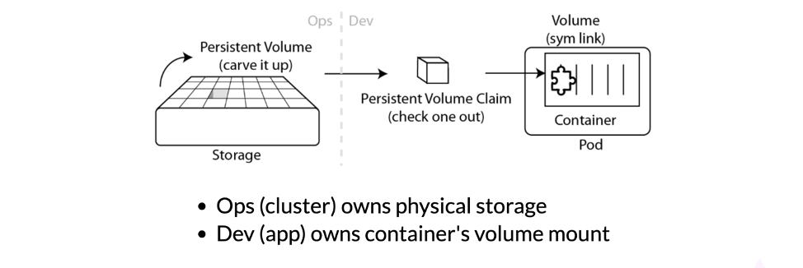
Kubernetes File Storage
Kubernetes File Storage, Configuration, and Secrets
95
Notes:
https://kubernetes.io/docs/concepts/architecture/
https://konghq.com/blog/learning-center/kubernetes-architecture

Slide 96
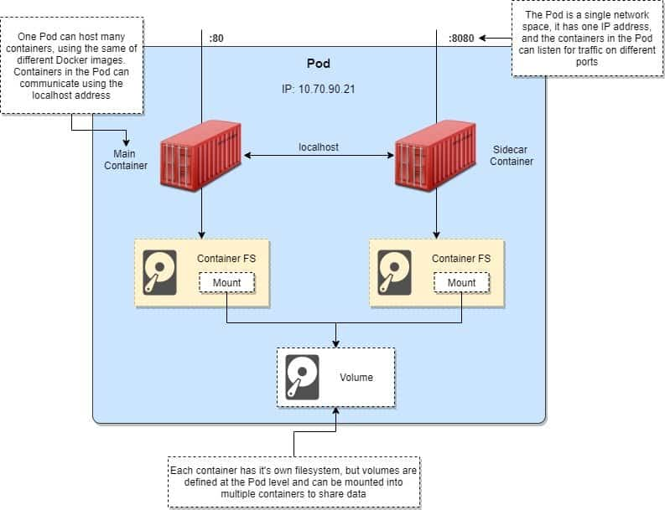
Kubernetes File Storage
Kubernetes sidecar example | Create multi-container Pod
96
Notes:
https://kubernetes.io/docs/concepts/architecture/
https://konghq.com/blog/learning-center/kubernetes-architecture

Slide 97
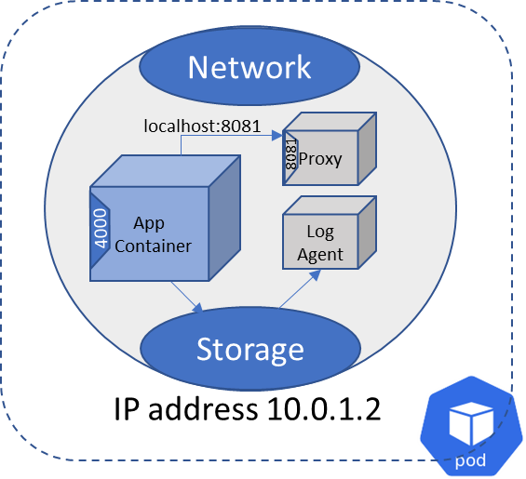
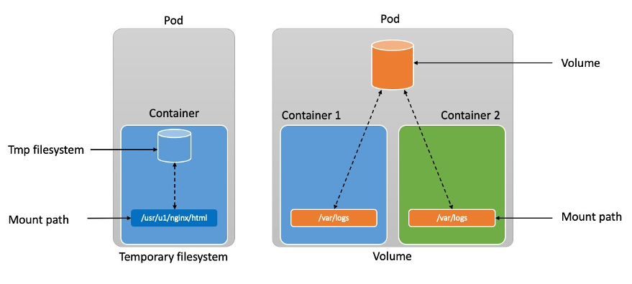
Kubernetes File Storage
97
Notes:
https://kubernetes.io/docs/concepts/architecture/
https://konghq.com/blog/learning-center/kubernetes-architecture

Slide 98
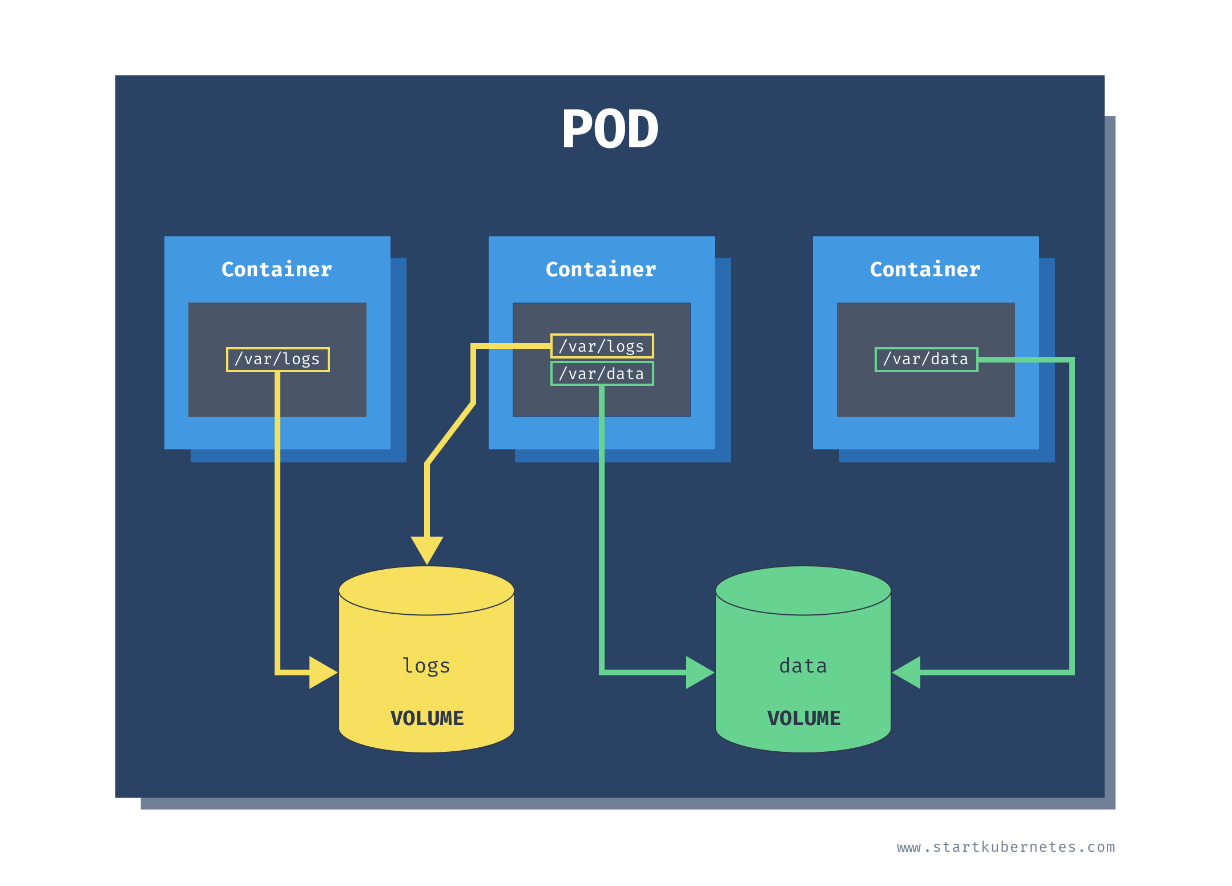
Kubernetes File Storage
98
Notes:
https://kubernetes.io/docs/concepts/architecture/
https://konghq.com/blog/learning-center/kubernetes-architecture

Slide 99
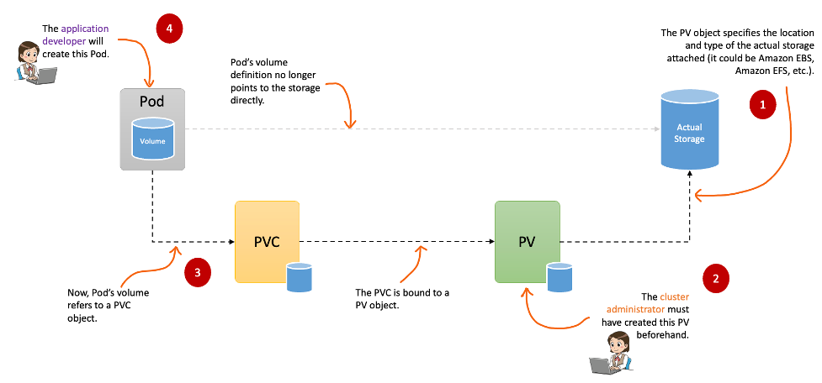
Kubernetes File Storage
99
Notes:
https://kubernetes.io/docs/concepts/architecture/
https://konghq.com/blog/learning-center/kubernetes-architecture

Slide 100
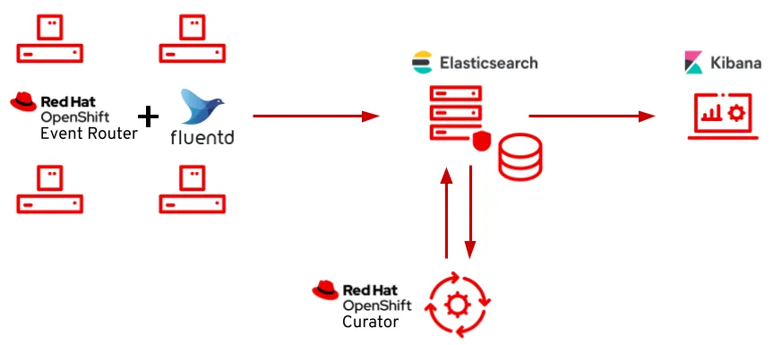
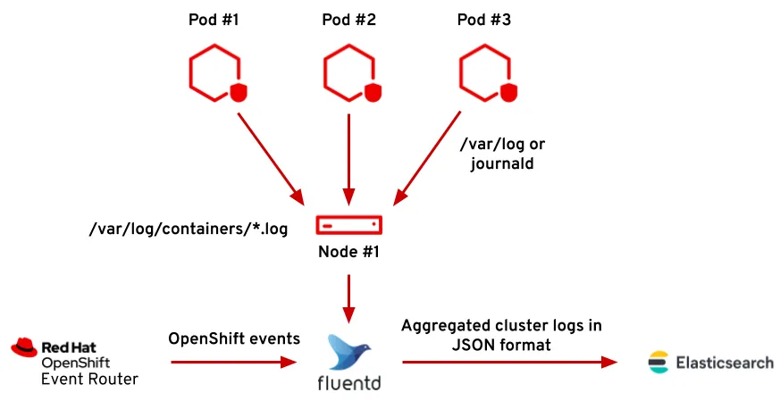
OpenShift 4 Logging Stack
https://www.redhat.com/en/blog/introduction-to-the-openshift-4-logging-stack
100
Notes:
https://kubernetes.io/docs/concepts/architecture/
https://konghq.com/blog/learning-center/kubernetes-architecture

Slide 101
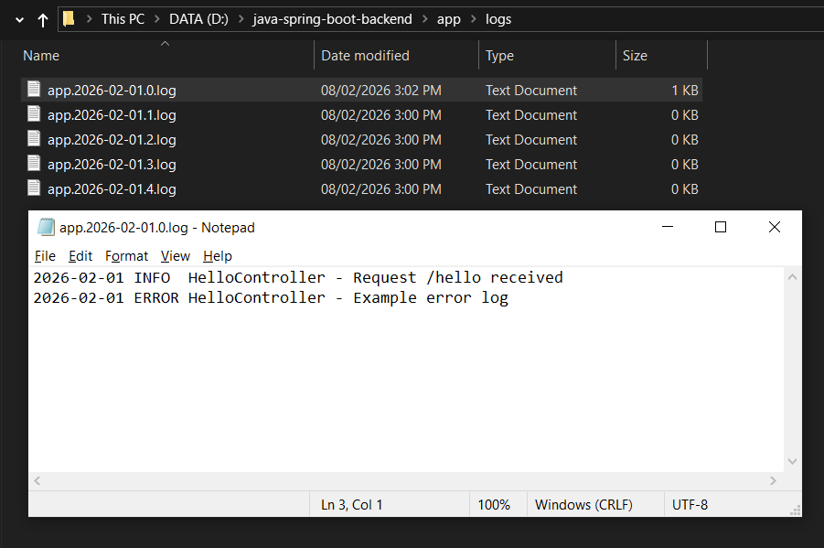
File Logging
101
Notes:
https://kubernetes.io/docs/concepts/architecture/
https://konghq.com/blog/learning-center/kubernetes-architecture

Slide 102
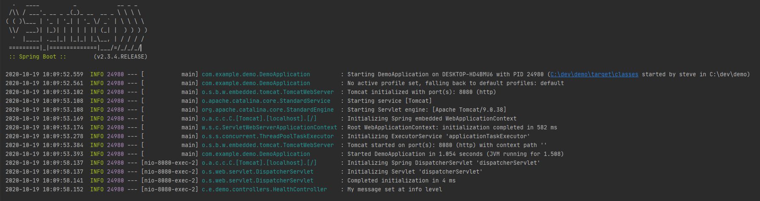
Console Logging
102
Notes:
https://kubernetes.io/docs/concepts/architecture/
https://konghq.com/blog/learning-center/kubernetes-architecture

Slide 103
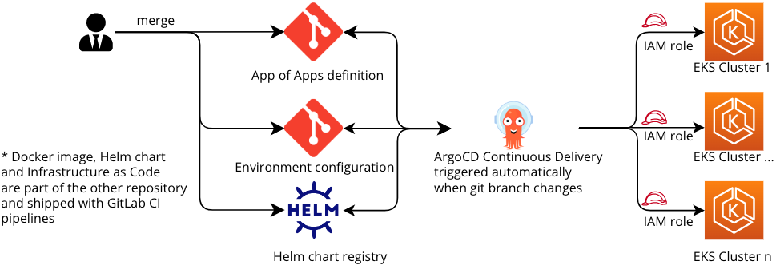
GitLab OpenShift ArgoCD
103
Notes:
https://kubernetes.io/docs/concepts/architecture/
https://konghq.com/blog/learning-center/kubernetes-architecture

Slide 104
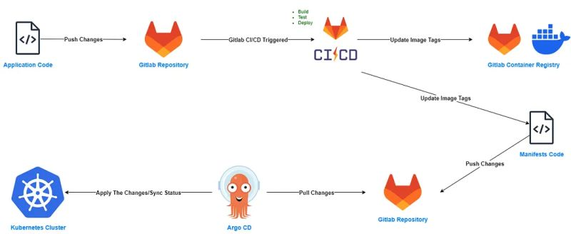
GitLab OpenShift ArgoCD
104
Notes:
https://kubernetes.io/docs/concepts/architecture/
https://konghq.com/blog/learning-center/kubernetes-architecture

Slide 105
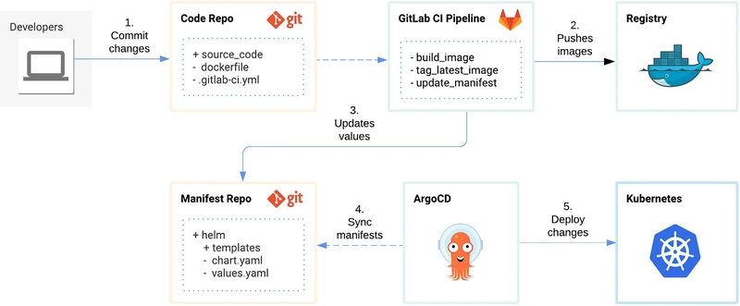
GitLab OpenShift ArgoCD
105
Notes:
https://kubernetes.io/docs/concepts/architecture/
https://konghq.com/blog/learning-center/kubernetes-architecture

Slide 106
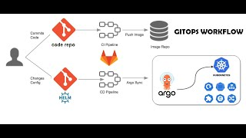
GitLab OpenShift ArgoCD
106
Notes:
https://kubernetes.io/docs/concepts/architecture/
https://konghq.com/blog/learning-center/kubernetes-architecture

Slide 107



Template source code
# Copy source code to container
COPY . .
# Build app for production - dist/build
RUN npm run build
Font chữ: Calibri
Lưu ý chung
Sử dụng tiếng Anh
Lưu ý kiểm tra ngữ pháp tiếng Anh
Size chữ:
Tiêu đề Level 1: Thống nhất trong quá trình làm thử
Tiêu đề Level 2: Thống nhất trong quá trình làm thử
Paragraph: Thống nhất trong quá trình làm thử
Các màu sử dụng:
Màu đỏ
Màu xanh lá
Màu xanh dương
Màu cam
Màu đen
107

Slide 108




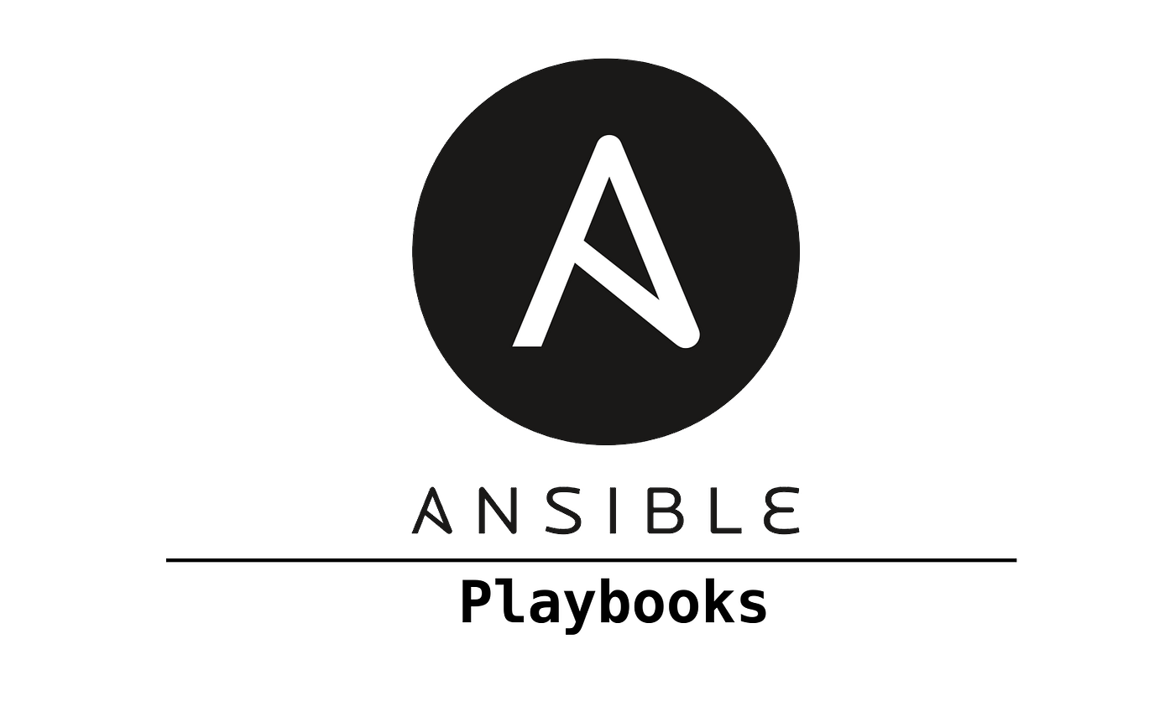

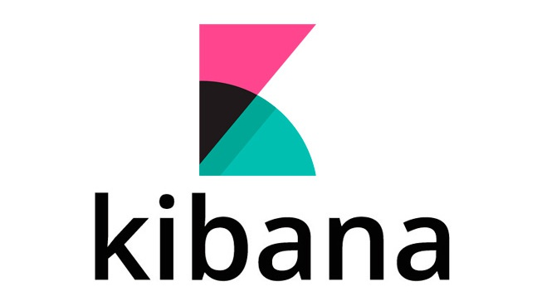


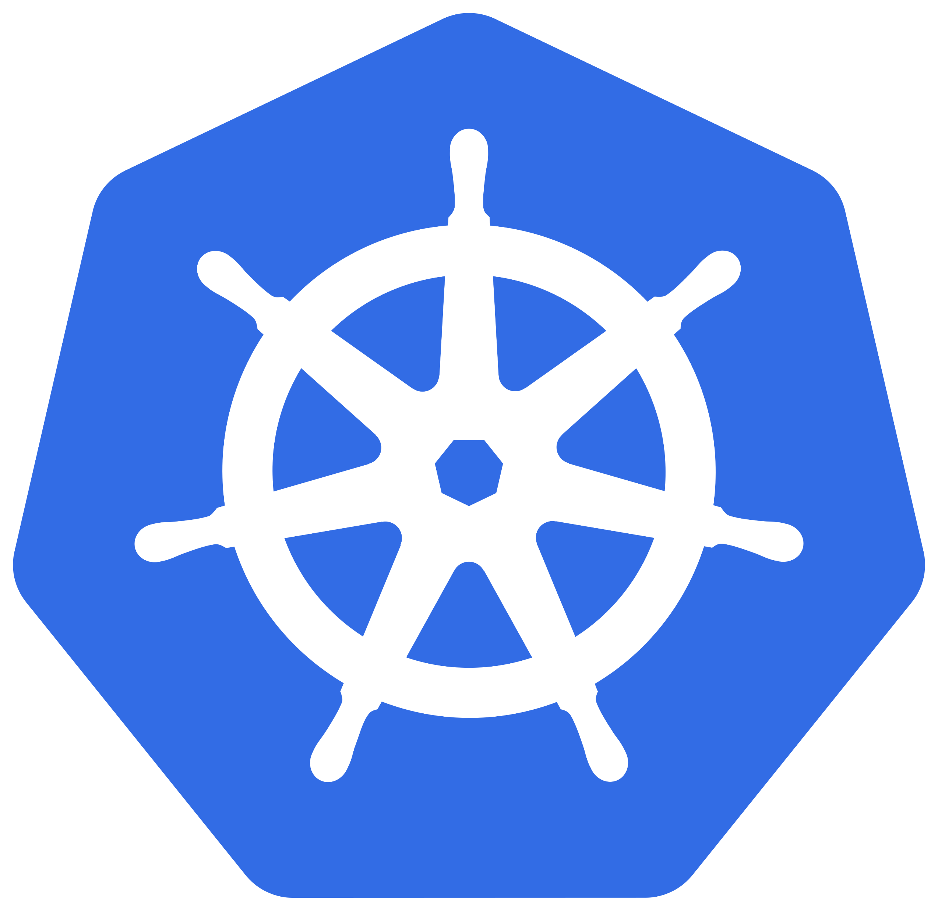

Template source code
108

Slide 109
THANK YOU
…

